Slide 1
Hamiltonian Cycle problem

Slide 2
Solution to Hamiltonian path in a graph
A Hamiltonian path is a simple open path that contains each vertex in a graph exactly once.
The Hamiltonian Path problem is the problem to determine whether a given graph contains a Hamiltonian path.
To show that this problem is NP-complete we first need to show that it actually belongs to the class NP and then find a known NP-complete problem that can be reduced to Hamiltonian Path.

Slide 3
For a given graph G we can solve Hamiltonian Path by non deterministically choosing edges from G that are to be included in the path.
Then we traverse the path and make sure that we visit each vertex exactly once. This obviously can be done in polynomial time, and hence, the problem belongs to NP.
Now we have to find an NP-complete problem that can be reduced to Hamiltonian Path.
A closely related problem is the problem to determine whether a graph contains a Hamiltonian cycle, that is, a Hamiltonian path that begin and end in the same vertex.
Moreover, we know that Hamiltonian Cycle is NP-complete, so we may try to reduce this problem to Hamiltonian Path

Slide 4
Given a graph G = (V, E) we construct a graph G’ such that G contains a Hamiltonian cycle if and only if G’ contains a Hamiltonian path.
This is done by choosing an arbitrary vertex u in G and adding a copy, u’ , of it together with all its edges. Then add vertices v and v’ to the graph and connect v with u and v’ with u’

Slide 5
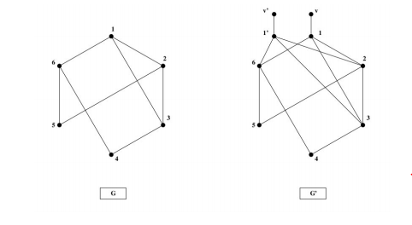
Suppose first that G contains a Hamiltonian cycle.
Then we get a Hamiltonian path in G’ if we start in v, follow the cycle that we got from G back to u’ instead of u and finally end in v’ .
For example, consider the left graph, G, in Figure which contains the Hamiltonian cycle 1, 2, 5, 6, 4, 3, 1. In G’ this corresponds to the path v, 1, 2, 5, 6, 4, 3, 1’ , v’ .

Slide 6
Conversely, suppose G’ contains a Hamiltonian path. In that case, the path must necessarily have endpoints in v and v’ . This path can be transformed to a cycle in G. Namely, if we disregard v and v’ , the path must have endpoints in u and u’ and if we remove u’ we get a cycle in G if we close the path back to u instead of u’.
Hence, we have shown that G contains a Hamiltonian cycle if and only if G’ contains a Hamiltonian path, which concludes the proof that Hamiltonian Path is NP-complete.

